Slide 1
Anxiety Associated with HAE Attacks: Results from the Phase 3 KONFIDENT Trial of Oral Sebetralstat
Timothy Craig,¹ Emel Aygören-Pürsün,² Jonathan A. Bernstein,³ Paula J. Busse,⁴ Teresa Caballero,⁵ Danny M. Cohn,⁶ Mar Guilarte,⁷ Henriette Farkas,⁸ Douglas H. Jones,⁹ Sorena Kiani-Alikhan,¹⁰ Michael E. Manning,^{11,12} Marcus Maurer,^{13,14} Marc A. Riedl,¹⁵ Sinisa Savic,¹⁶ H. James Wedner,¹⁷ Patrick F. K. Yong,¹⁸ Andrea Zanichelli,^{19,20} Erik Hansen,²¹ James Hao,²¹ Michael D. Smith,²¹ Christopher M. Yea,²¹ Paul K. Audhya,²¹ William R. Lumry²²
¹Pennsylvania State University, Hershey, PA, USA; Vinmec International Hospital, Times City, Hanoi, Vietnam; ²University Hospital Frankfurt, Goethe University Frankfurt, Frankfurt, Germany; ³University of Cincinnati College of Medicine, and Bernstein Clinical Research Center, Cincinnati, OH, USA; ⁴Icahn School of Medicine at Mount Sinai School of Medicine, New York, NY, USA; ⁵Hospital Universitario La Paz, Hospital La Paz Health Research Institute (IdiPAZ), Biomedical Research Network on Rare Diseases (CIBERER), Madrid, Spain; ⁶Amsterdam University Medical Center, University of Amsterdam, Amsterdam, Netherlands; ⁷Hospital Universitari Vall d'Hebron, Vall d’Hebron Research Institute (VHIR), Barcelona, Spain; ⁸Hungarian Angioedema Center of Reference and Excellence, Semmelweis University, Budapest, Hungary; ⁹Rocky Mountain Allergy, Asthma, and Immunology, Layton, UT, USA; ¹⁰University College London, London, UK; ¹¹Medical Research of Arizona, Scottsdale, AZ, USA; ¹²University of Arizona College of Medicine-Phoenix, Phoenix, AZ, USA; ¹³Institute of Allergology, Charité-Universitätsmedizin Berlin, corporate member of Freie Universitätsmedizin Berlin and Humboldt-Universität zu Berlin, Berlin, Germany; ¹⁴Fraunhofer Institute for Translational Medicine and Pharmacology ITMP, Immunology and Allergology, Berlin, Germany; ¹⁵University of California, San Diego, La Jolla, CA, USA; ¹⁶The Leeds Institute of Rheumatic and Musculoskeletal Medicine, University of Leeds, Leeds, UK; ¹⁷Washington University School of Medicine, St. Louis, MO, USA; ¹⁸Frimley Health NHS Foundation Trust, Frimley, UK; ¹⁹Operative Unit of Medicine, Angioedema Center, IRCCS Policlinico San Donato, San Donato Milanese, Milan, Italy; ²⁰University of Milan, Milan, Italy; ²¹KalVista Pharmaceuticals, Salisbury, United Kingdom, and Cambridge, MA, USA; ²²AARA Research Center, Dallas, TX, USA

Slide 2
Disclosures
Timothy Craig has received grants, consulting fees, honoraria, and/or served as an advisory boards and/or data safety monitoring for KalVista Pharmaceuticals, Astria, Takeda, BioMarin Pharmaceuticals, BioCryst, CSL Behring, Grifols, GSK, Intellia Therapeutics, Ionis Pharmaceuticals, Pharming, and Pharvaris; serves as the director for ACARE International Hereditary Angioedema Center and Alpha-1 Resource Center; and is a member of the Medical Advisory Board for the HAE-A\
This study was funded by KalVista Pharmaceuticals

Slide 3
Background
Anxiety in people living with HAE is underappreciated
The unpredictable, painful, and life-threatening nature of HAE attacks is associated with substantial psychological burden¹⁻⁵
Nearly one-third of respondents from a recent international survey of HAE patients (n=284) experienced moderate to extreme anxiety due to anticipated use of parenteral on-demand treatment (see our associated poster presentation)⁶
Unpredictable timing of attacks
Attack-associated anxiety
Treatment-associated anxiety
Fear associated with the anticipation of the next attack
Impact of attack symptoms
Stress of injecting or infusing on-demand therapy
The objective of this analysis was to assess the impact of sebetralstat, an investigational oral plasma kallikrein inhibitor for the on-demand treatment of HAE attacks, on attack-related anxiety

Slide 4
KONFIDENT Trial Design and Anxiety Endpoints as Measured by Generalized Anxiety Numeric Rating Scale (GA-NRS)
Confirmed diagnosis of HAE-C1INH
Age ≥12 years
≥2 attacks within 3 months
Stable LTPª
R^{b}
Attack treated with sebetralstat 300 mg or 600 mg, or placebo
0.5 h
eDiary entry schedule:
Baseline
4 h
12 h
24 h
GA-NRS: “How anxious do you feel right now?”
0
1
2
3
4
5
6
7
8
9
10
Not at all anxious
Mildly
anxious
Moderately
anxious
Extremely
anxious
Anxiety was recorded by use of GA-NRS at the time points above and analysed as the following endpoints
Cumulative GA-NRS score: Area under the curve (AUC) from treatment administration to 12 or 24 hours (AUC₀₋₁₂ or AUC₀₋₂₄)^{c}
Least squares mean (LSM) change from baseline at 4- and 12-hours post-baseline
Time to a ≥2-point reduction in GA-NRS score at ≥2 consecutive time points and agreement with time to beginning of symptom relief within 12 hours (the primary endpoint of the KONFIDENT trial)^{d,e,f}
Correlation between GA-NRS rating and baseline demographics and attack characteristics^{g}

Slide 5
Attacks Inducing Moderate to Extreme Anxiety
In 261 attacks for which there are GA-NRS records in KONFIDENT, the median GA-NRS score was 3.0 at baseline
115 attacks (44%) induced moderate to extreme anxietyª at baseline
Factors associated with increased anxiety at the onset of an attack included
Female sex (vs male, P=0.0034)
Shorter time since HAE diagnosis (vs longer time, P=0.0014)
Moderate or severe/very severe baseline attack severity
Moderate (vs mild, P=0.0030)
Severe/very severe (vs mild, P<0.0001)
 | All attacks¹ N=264 | Attacks inducing moderate to extreme anxiety n=115/261^{b} (44%)
Baseline PGI-S category^{c}
Mild^{d} | 115 (43.6) | 38 (33.0)
Moderate | 102 (38.6) | 47 (40.9)
Severe/very severe | 45 (17.0) | 30 (26.1)
Baseline primary attack location^{c}
Abdomen | 114 (43.2) | 57 (49.6)
Legs/feet | 62 (23.5) | 33 (28.7)
Arms/hands | 76 (28.8) | 30 (26.1)
Head/face/neck | 29 (11.0) | 12 (10.4)
Larynx/throat | 8 (3.0) | 4 (3.5)
Genitals | 9 (3.4) | 3 (2.6)
Time from onset to first administration, median (IQR), minutes | 41 (6-140) | 45 (6-155)

Slide 6
Reduction in Cumulative GA-NRS Scores
All attacks
Attacks inducing moderate to extreme anxiety
Sebetralstat 300 mg
Sebetralstat 300 mg
Sebetralstat 600 mg
Sebetralstat 600 mg
Placebo
Placebo
GA-NRS Score, Mean (±SE)
GA-NRS Score, Mean (±SE)
Time from First Study Drug Administration, Hours
Time from First Study Drug Administration, Hours
Compared with placebo for all attacks, on-demand treatment with sebetralstat significantly reduced the AUC₀₋₁₂ (300 mg, P=0.0040; 600 mg, P=0.0008) and AUC₀₋₂₄ (300 mg, P=0.0220; 600 mg, P=0.0012)
When attacks with moderate to extreme anxiety were assessed, reductions in anxiety were greater than in all attacks

Slide 7
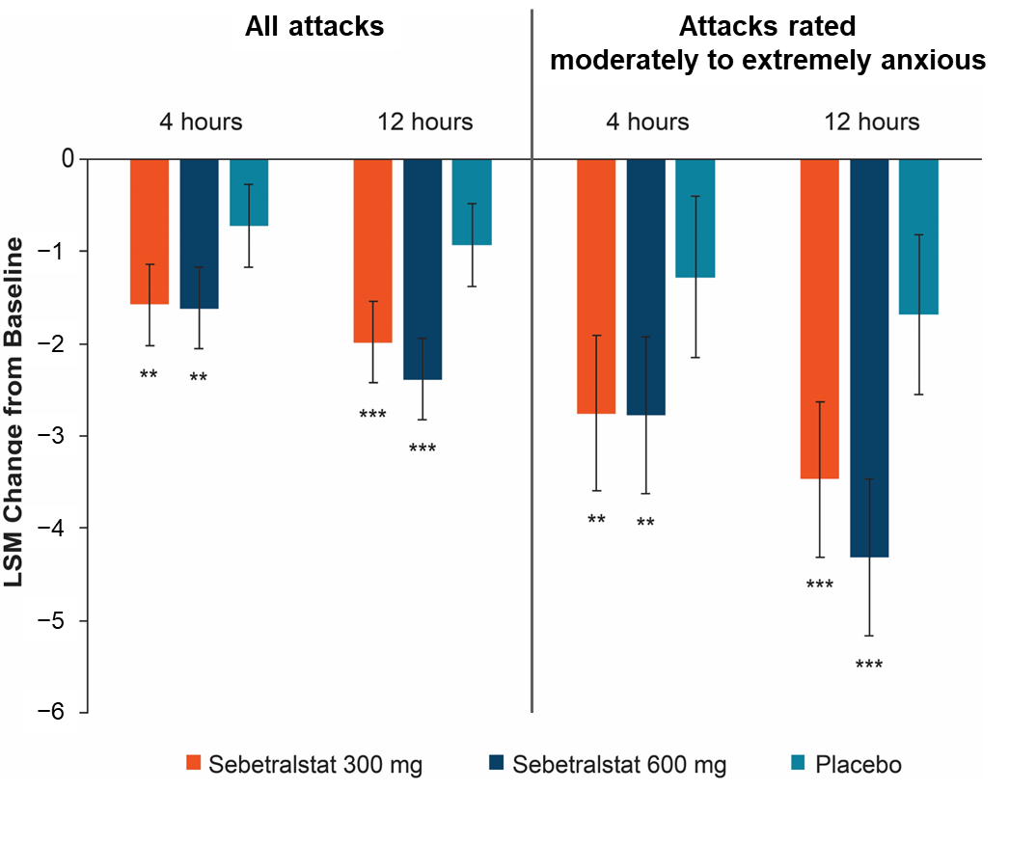
Changes in LSM Change from Baseline in HAE Attacks in KONFIDENT
Significantly greater changes from baseline in GA-NRS score were observed at 4 and 12 hours for attacks treated with sebetralstat compared with placebo
LSM change from baseline was more pronounced in attacks that induced moderate to extreme anxiety than with all attacks

Slide 8
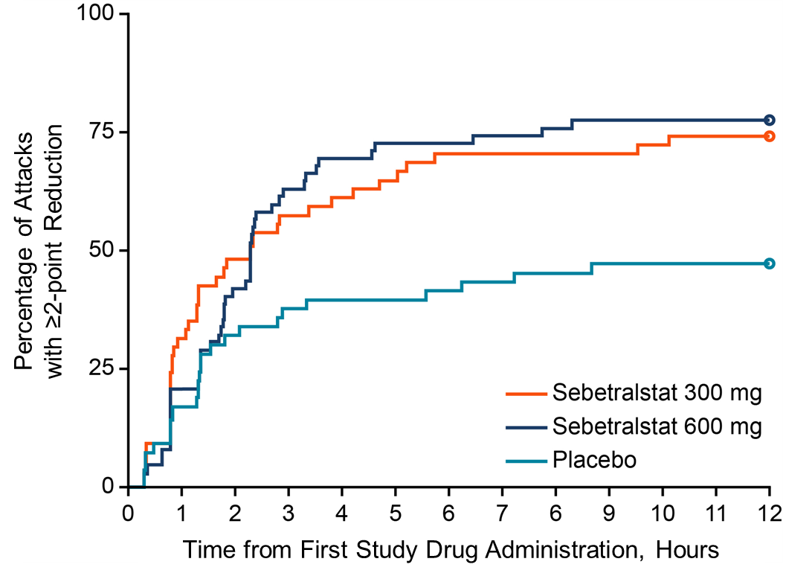
Time to Reduction in Anxiety in KONFIDENT
The median time to reduction in anxietyª in KONFIDENT for attacks treated with sebetralstat 300 mg or 600 mg was 2.3 hours (IQR: 0.8 to 10.1 and 1.3 to 5.5, respectively)
For placebo, the median was >12 hours
The time to reduction in anxiety highly correlated with the primary and key secondary endpoints in KONFIDENT
Time to beginning of symptom relief (P<0.0001)^{b,c}
Time to reduction in severity (P<0.0001)^{b,c}
Time to complete attack resolution (P<0.0001)^{b,d}
Percentage of Attacks with ≥2-point Reduction in GA-NRS at ≥2 Consecutive Time Points

Slide 9
Agreement of ≥2-point Reduction in Anxiety with Achievement of Beginning of Symptom Relief
Characteristic | Beginning of symptom reliefª within 12 hours
 | Correlation to reduction in anxiety within 12 hours,^{b,c} kappa (P value)
All attacks | 0.47 | (<0.0001)
Attacks that induced moderate to severe anxiety | 0.49 | (<0.0001)
By attack location
Mucosal attacks | 0.55 | (<0.0001)
Abdominal attacks | 0.44 | (0.0005)
Subcutaneous attacks | 0.39 | (0.0002)
By treatment paradigm
On-demand only | 0.46 | (<0.0001)
On-demand + LTP | 0.51 | (0.0013)
By age group
≥12 to <18 years | 0.42 | (0.0671)
≥18 years | 0.48 | (<0.0001)
Participants who had attacks achieving beginning of symptom relief earlier (within 12 hours) had a greater chance to reach meaningful reductions in anxiety (≥2 points) regardless of attack location, treatment paradigm, and age

Slide 10
Conclusions
In the phase 3 KONFIDENT trial, anxiety was rated as moderate to extreme at the time of treatment in >40% of attacks
In the absence of injectables, anxiety was correlated with baseline attack severity
Compared with placebo, on-demand treatment with sebetralstat reduced anxiety, especially in attacks rated as inducing moderate to extreme anxiety
The median time to reduction in anxiety was 2.3 hours with sebetralstat and >12 hours with placebo
The time to reduction in anxiety highly correlated with the primary and key secondary endpoints in KONFIDENT

Slide 11
Acknowledgments
We thank the people living with HAE and their families; the HAEA, HAEi and member organizations, and the investigator teams who contributed to the international KONFIDENT trial
Medical writing assistance was provided under the direction of the authors by Richard W. Davis IV, PhD, of ApotheCom (San Francisco, CA), and was supported by KalVista Pharmaceuticals

